Slide 1

Classification & types of Computers

Slide 2
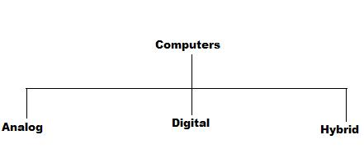
Types of computers
Types of Computers based on Principles of Operation.
There are three different types of computers according to the principles of operation. Those three types of computers are
1.Analog Computers
2.Digital Computers
3.Hybrid Computers

Slide 3
Analog Computers
Analog Computer is a computing device that works on continuous range of values.
In analog technology, information is translated into electric pulses of varying amplitude.
The results given by the analog computers will only be approximate since they deal with quantities that vary continuously.
It generally deals with physical variables such as voltage, pressure, temperature, speed, etc.
Digital Computers
Digital computer operates on digital data such as numbers.
It uses binary number system in which there are only two digits 0 and 1. Each one is called a bit.
Digital Computers can give more accurate and faster results.
Digital computer is well suited for solving complex problems in engineering and technology.
Hence digital computers have an increasing use in the field of design, research and data processing.

Slide 4
Hybrid Computers
A hybrid computer combines the desirable features of analog and digital computers.
It is mostly used for automatic operations of complicated physical processes and machines.
Now-a-days analog-to-digital and digital-to-analog converters are used for transforming the data into suitable form for either type of computation.
For example, in hospital’s ICU, analog devices might measure the patients temperature, blood pressure and other vital signs.
These measurements which are in analog might then be converted into numbers and supplied to digital components in the system.
These components are used to monitor the patient’s vital sign and send signals if any abnormal readings are detected.
Hybrid computers are mainly used for specialized tasks.

Slide 5
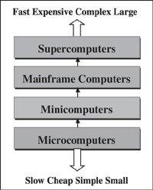
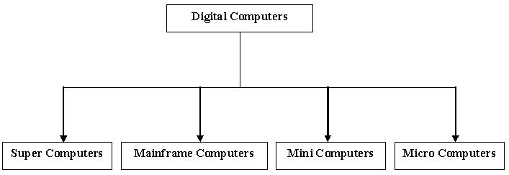
CLASSIFICATION OF COMPUTERS
There are four different types of computers when we classify them based on their performance and capacity. The four types are
1. Super Computers
2. Mainframe Computers
3. Mini Computers
4. Micro Computers

Slide 6
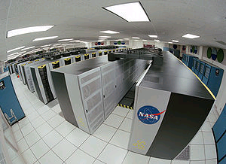
Super computers
Super computers are the best in terms of processing capacity and also the most expensive ones.
These computers can process billions of instructions per second.
Normally, they will be used for applications which require intensive numerical computations such as stock analysis, weather forecasting etc.
Other uses of supercomputers are scientific simulations, (animated) graphics, fluid dynamic calculations, nuclear energy research, electronic design, and analysis of geological data.
Are the most powerful available. These computers are being used by very big organizations mostly big corporations and government institutions.

Slide 7
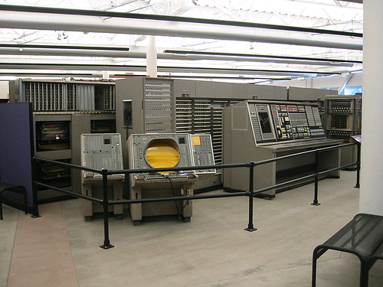
Mainframe computers
Are less powerful than super computers but are capable of great processing speed, multi tasking capability and high data storage.
It is multi terminal computer which can be shared simultaneously by multi users.
They are used by most banks to process information of depositors and millions of daily bank transactions.
Insurance companies use them for their policy holders database. It is also used in airlines, railways & educational sector.
These computers have specialized wiring system and usually occupies a big room with temperature control.

Slide 8
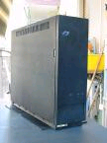
Mini computers
It is smaller, less expensive, and less powerful than a mainframe.
Are used for medium sized companies for specific purposes.
They are also called mid range computers.
They may be used for certain assembly line operations
or manufacturing stages in big companies.
It also used for network applications server to support workstations.
The size of mini computers may be as a fridge commonly used in homes.
more expensive and more powerful than a personal computer.

Slide 9
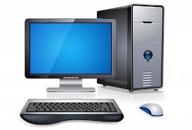
Microcomputers or desktop Computers
Are the most common and widely used computer today.
There are two types of microcomputers, the desktop computers and the notebook computer or laptop.
Desktop computers are the common computer that you see in homes, colleges, and in most businesses.
use at a single location desk/table due to its size and power requirements
They are small enough to be placed on a desk or table but are too big to be carried around.
Desktop computer have four common components
1.Monitor 2.CPU3.Key Board 4.Mouse

Slide 10
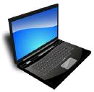
Notebook Computer
also known as laptop.
These type of computers are portable, lightweight and are easy to carry around.
In Laptop computer monitor cpu keyboard and mouse are integrated into one unit.

